Slide 1
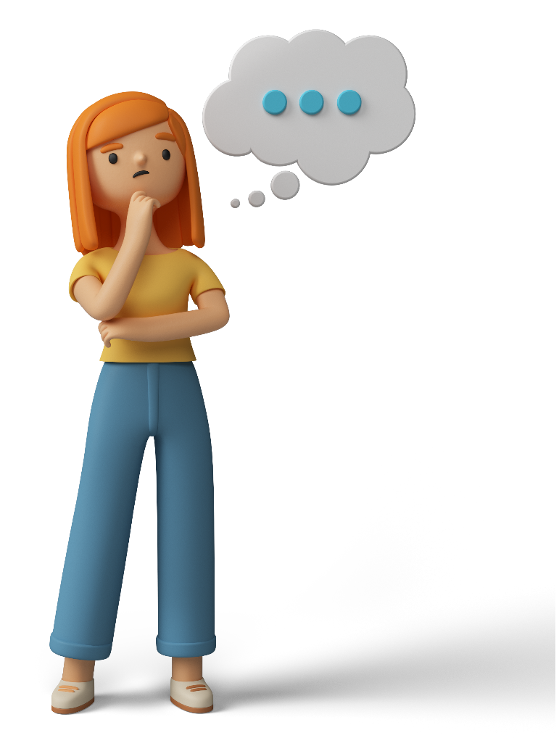
Adjectives to Describe People
attractive – She is a very attractive woman.
bald – I have a bald head.
beautiful – You have beautiful eyes.
big – He has a big nose.
blonde – She has blonde hair.
black – My mom has long black hair.
blue – He has blue eyes.
brown – She has brown eyes.
chubby – The boy has chubby cheeks.
cute – Look at that cute baby.
fat – I’m looking a little fat these days.
funny – The clown has a funny face.

Slide 2
Adjectives to Describe People
gorgeous – You look absolutely gorgeous in that dress.
handsome – You look very handsome in your suit.
large – The clown also has very large feet.
long – Your fingernails are too long.
old – The old man is sitting watching TV.
oval – The child had a cute oval face.
pretty – Look how pretty she is!
round – The girl has a round face.
short – I am very short compared to my brothers.
slim – You look slim. Have you lost some weight?
small – She has a small nose.
stylish – Your hair is very stylish.

Slide 3
Adjectives to Describe People
tall – She is very tall compared to me.
thick – She had thick blonde hair.
thin – You look very thin these days.
ugly – The witch was very ugly.
white – The old man has white hair.
yellow – The ugly witch has yellow teeth.
young – The young boy is playing in the park.

